Slide 1

SSMIF Macro Outlook
Fall 2017
STEVENS INSTITUTE of TECHNOLOGY
STUDENT MANAGED INVESTMENT FUND

Slide 2
Agenda
Macro Strategy Group
State of US Economy and the direction it is moving
Trump Policies, or lack there of…
Market Trends
Sector Outlooks
Asset Allocation

Slide 3
US Economy - GDP
Macro Strategy Group
Strong consumer spending and nonresidential investment led to strongest GDP reading in 2 years, however…
Long Term FOMC projections point to continued tepid economic growth
Q2’17 Real GDP: 3%
Revised up from 2.6%
Long run US GDP growth pegged at 1.8%...continuing trend of weak economic recovery beginning 2009
Federal Reserve Economic Database
Real Gross Domestic Product, Percent Change from Preceding Period, Quarterly, Seasonally Adjusted Annual Rate
https://www.federalreserve.gov/monetarypolicy/fomcprojtabl20170315.htm
Real Gross Domestic Product, Percent Change from Preceding Period, Quarterly, Seasonally Adjusted Annual Rate

Slide 4
US Economy - Consumers
Macro Strategy Group
Although consumers have been spending more it has been done largely on credit
Consumer Confidence is at post-recession high despite tepid wage growth
Growth in consumer credit has outpaced spending since 2015
Federal Reserve Economic Database
Real Personal Consumption Expenditures, Percent Change from Preceding Period, Quarterly, Seasonally Adjusted Annual Rate
Consumer Loans: Credit Cards and Other Revolving Plans, All Commercial Banks, Percent Change at Annual Rate, Quarterly, Seasonally Adjusted
Federal Reserve Economic Database
Employed full time: Median usual weekly real earnings: Wage and salary workers: 16 years and over, 1982-84 CPI Adjusted Dollars, Quarterly, Seasonally Adjusted
Conference Board Consumer Confidence

Slide 5
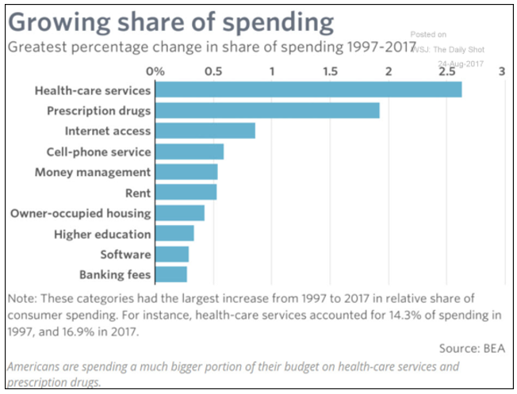
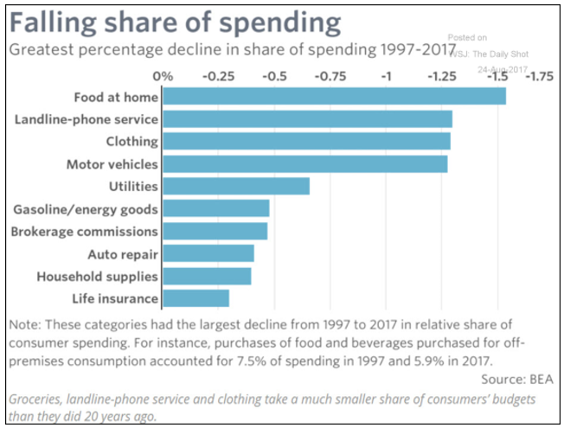
US Economy – Consumers…What are they Buying?
Macro Strategy Group

Slide 6
US Economy – Productivity & Population
Macro Strategy Group
Two key drivers of economic expansion are productivity growth and population growth… We have seen consistently weak productivity growth in the US over the past 10 years and population growth is at a historic low… If these trends continue the US may face stagnation similar to that of Japan
Bureau of Labor Statistics
Nonfarm Business Labor Productivity, Percent change from previous quarter at Annual Rate
Federal Reserve Economic Database
Population: Mid-Month, % Change from Prior Period, Monthly, Not Seasonally Adjusted

Slide 7
US Economy – Inflation and Unemployment
Macro Strategy Group
Inflation continues to come in below expectations and the Fed’s target rate of 2%...
Despite unemployment levels remaining below the NAIRU since April of 2016… economy is structurally different
NAIRU (5%)
After increasing for 4 consecutive quarters and nearly reaching 2%, inflation has declined since end of 2016
Federal Reserve Economic Database
Personal Consumption Expenditures excluding Food and Energy (chain-type price index), Percent Change from Quarter One Year Ago, Quarterly, Seasonally Adjusted University of Michigan Inflation Expectation
Federal Reserve Economic Database
Civilian unemployment rate

Slide 8
US Economy: Housing Market
Macro Strategy Group
Housing and rent prices continue to rise sharply while at same time housing supply and rental vacancies tick up…indication of correction?
Federal Reserve Economic Database
S&P/Case-Shiller U.S. National Home Price Index©, Percent Change from Year Ago, Monthly, Seasonally Adjusted
Consumer Price Index for All Urban Consumers: Rent of primary residence, Percent Change from Year Ago, Monthly, Seasonally Adjusted
Federal Reserve Economic Database
Monthly Supply of Houses in the United States, Months' Supply, Monthly, Seasonally Adjusted
Rental Vacancy Rate for the United States, Percent, Quarterly, Not Seasonally Adjusted

Slide 9
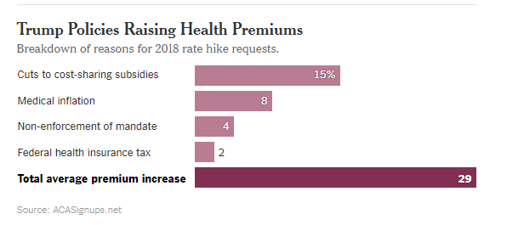
Trump – Healthcare Reform? Biotech Deregulation?
Macro Strategy Group
After 6 months of Healthcare debate in Congress, no reform passed…Trump administration has moved on to Tax Reform…
After healthcare bill failed to pass, President Trump threatened to end subsidies... If he does it will have serious ramifications regarding insurance premiums
I.
Nov. 8, 2016
Trump Elected
II.
Mar. 12, 2017
CBO releases analysis on AHCA bill projecting 52 million would be left uninsured
III.
Mar. 21, 2017
AHCA bill pulled from floor due to imminent failure
IV.
May 4, 2017
Revised AHCA bill is passed by the House
V.
Jul. 27, 2017
HCFA (“Skinny Repeal”) is narrowly defeated in Senate
V.
II.
III.
IV.
I.

Slide 10
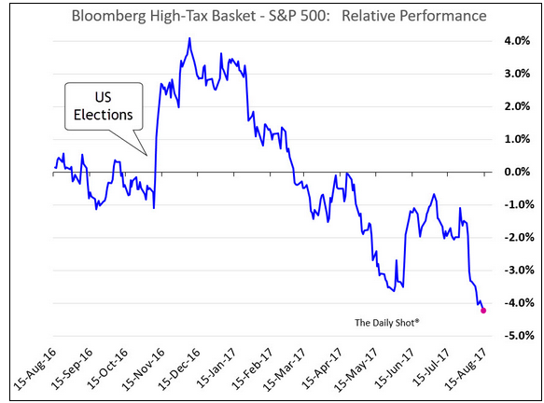
Trump – Tax Cuts?
Macro Strategy Group
Corporate Tax
Lower corporate tax rate from 35% to 15%
Regime shift from US having one of highest tax rates among developed countries to one of lowest
Individual Tax Brackets
Simplification from current 7 tax brackets to 3
10%, 25%, 30%
Repatriation
Possibility of one-time tax holiday for profits held overseas at 10% level
Balanced Budget
Income brackets have yet to be defined
One of the caveats of the passaged of tax reform is that it will not add to the federal deficit
One proposition to achieve this is to eliminate interest rate deductions
This would affect the US corporate bond market, as well as highly leveraged companies
US companies hold ~$2.5 trillion cash overseas
High tax companies have given up post-election bounce as investors faith in the Trump administration enacting meaningful tax reform fades

Slide 11
Trump – NAFTA
Macro Strategy Group
7 rounds of negotiations between US, Canada and Mexico with the second round concluding Sept. 5. President Trump has stated he will pull out of agreement completely if negotiations do not go his way.
Canada
2nd largest trade partner in 2016 with $544B in total (two way) goods traded
$12.1B trade deficit in 2016
Mexico
3rd largest trade partner in 2016 with $521.1B in total (two way) goods traded
$63.2B trade deficit in 2016
1st largest goods export market in 2016; $266B, up 165% from 1993 (pre-NAFTA)
Largest agricultural export market; $23B in 2016
Other Top Export Categories:
Vehicles ($48B); Machinery ($40B); Mineral Fuels ($16B)
3rd Largest supplier of goods; $278.1B in 2016
2nd largest goods export market in 2016; $231B, up 455% from 1993 (pre-NAFTA)
1.6 million jobs supported by trade
3rd largest agricultural export market; $18B in 2016
Other Top Export Categories:
Machinery ($42B); Vehicles ($21B); Mineral Fuels ($16B)
2nd largest supplier of goods; $294.2B in 2016
Vehicles ($58B); Mineral Fuels ($54B)
Vehicles ($75B); Electrical Machinery ($62B)
1.2 million jobs supported by trade
Bloomberg Price Data

Slide 12
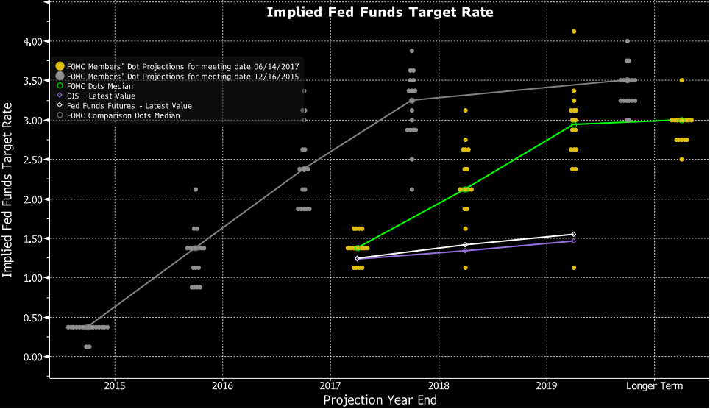
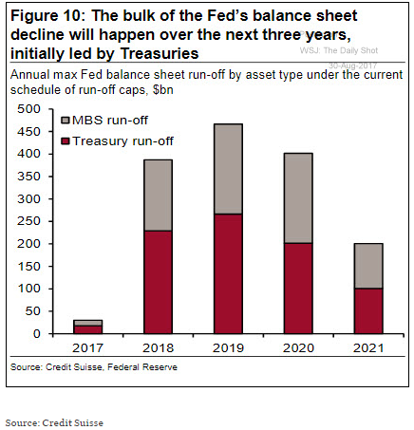
Monetary Policy: Stalled Hikes & Unwinding of BS
Macro Strategy Group
QE 3
QE 2
Operation Twist
QE 1
Fed has indicated they may start run-off process before end of year…a lot of demand for treasuries and MBS’s will be coming off the table
Since Fed raised rates for first time at end of 2015, they have continually pushed back projections for future hikes.

Slide 13
Market Trends: Yield Curve
Macro Strategy Group
0
5
10
15
20
25
30
Bloomberg price data
Bloomberg Curve Data

Slide 14
Market Trends: Weak Dollar
Macro Strategy Group
After the surprise election of Trump and expectation for 3 rate hikes from the FED in 2017 the dollar index rose 6% in a month. However, as inflation data continues to underwhelm (putting doubts in future tightening from FED) and pro-growth policies fail to be enacted the dollar is down ~10% YTD
Price data from Bloomberg. The Dollar index is DXY Index.

Slide 15
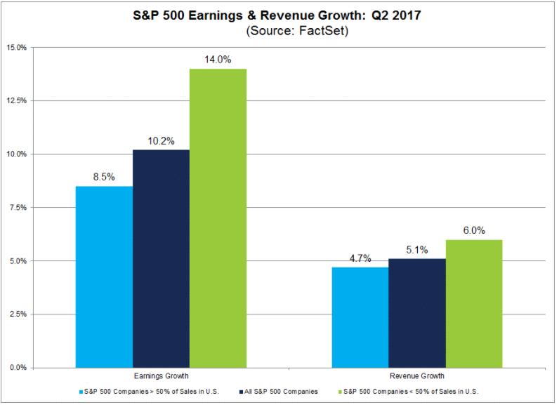
Market Trends: US Multinationals Win
Macro Strategy Group

Slide 16
Market Trends: US Debt Market
Macro Strategy Group
Investors return to bond market in 2017 after their post-election sell-off…
And corporations take advantage of low rates…what will happen to US debt issuance if interest rate deductions are removed??
Bloomberg price data
Bloomberg Debt Issuance data

Slide 17
Market Trends: Commodities - Metals
Macro Strategy Group
Industrial metals are up ~20% this year alongside strong Chinese economic data
Bloomberg China Consumption Data
Bloomberg price data
National Bureau of Statistics of China

Slide 18
Market Trends: Commodities - Oil
Macro Strategy Group
Bloomberg price data

Slide 19
Market Trends: YTD/Post-Election Returns
Macro Strategy Group
Financials and Industrials have given up some of their outperformance in 2017 after rallying post election
Equities have been on a tear outside the US with EM and Developed economies looking strong… if you factor in currency valuations US has underperformed
Bloomberg price data
Bloomberg price data

Slide 20
Market Trends: What’s going on with Tech?
Macro Strategy Group
Biggest names in Tech are propping up the market…potential opportunities in those left behind?
Semiconductors are up 42% ttm and for good reason…global manufacturing orders are up 50% YoY!!
Nearing all time low
Bloomberg price data

Slide 21
Market Trends: Banking Rally Stalls
Macro Strategy Group
US Banking Index rallied ~40% post election hitting a high in March 2017. Have since retreated 5% as Fed outlook appears dovish and yield curve flattens
Bloomberg price data

Slide 22
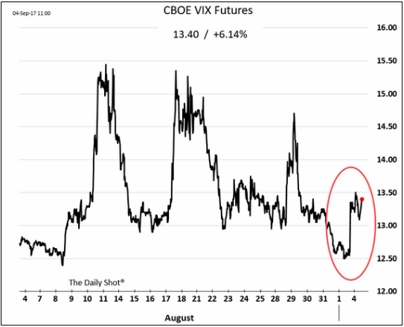
Market Trends: Rocky August…North Korean Threats
Macro Strategy Group
Charlottesville, White House jitters
North Korea Launches missile over Japan
North Korea Threats…Trump “Fire & Fury”
North Korea announces they have developed Hydrogen Bomb

Slide 23
Market Trends: Value Undervalued
Macro Strategy Group
Bloomberg price data
Bloomberg price data

Slide 24
Market Trends: US Equities Overvalued?…How long can Bull Market Last
Macro Strategy Group
Across various valuation metrics the S&P 500 appears to be overvalued
Second longest bull market ever which has entered into period of low volatility
Aug. 2011 European Debt Crisis and Standard and Poor downgrades US gov’t debt
Aug. 24, 2015 (“Black Monday”) global equity sell-off as Chinese devalue yuan

Slide 25
Guidance: Bullish
Macro Strategy Group
Technology
Tech companies continue to supply huge upside potential and are priced accordingly…key to consider relative valuations
Big Data, AI/Machine Learning, Semiconductors, Gaming, and Cybersecurity are a few areas we should look to target
Healthcare
Consumers are spending an increasing amount of their disposable income on healthcare; Healthcare expenditures rose 6.2% in 2016 according to the BLS (3rd largest increase after cash contributions to retirement plans and personal insurance)
Less uncertainty in market after Republicans failed pass reform and have turned attention else where
Utilities
Stable industry that delivers consistent returns
Attractive yields that will continue to be sought after while low inflation road blocks the Fed’s tightening plans
SSMIF has no exposure and has missed out on past 2 years gains, lets get some skin in the game before its too late

Slide 26
Guidance: Neutral
Macro Strategy Group
Financials
Yield curve has flattened and we haven’t seen the broad deregulation hoped for at the start of the year
However, as the world moves online there are opportunities in Fin Tech
Consumer Discretionary
Opportunities in video game and broader entertainment segments
Companies that are making efficient shift to ecommerce with stable margins
Telecomm
Market has become extremely saturated and we have seen heavy M&A activity in the sector
SSMIF has heavy allocation, maybe look to diversify current allocation
Industrials
Market has already priced in current administrations promised infrastructure package
Look into aero-space and defense…space will soon be the new frontier and defense spending is projected to increase globally
Risks seem to asymmetrical

Slide 27
Guidance: Bearish
Macro Strategy Group
REIT
Housing prices above pre-crisis levels
Inventory starting to build up
Is a correction around the corner?
Energy
Entrenched in a low price regime with no obvious way out
No one is willing to cut production to levels that are needed to level supply/demand imbalance
Fundamental shift away from petrochemicals and toward alternatives
Electric vehicles will soon be the norm
Globally governments are making a push toward green

Slide 28
Asset Allocation
Macro Strategy Group

Slide 29
SSMIF Macro Strategy Group:
Macro Strategy Group
Charles Manzari,
Macroeconomic Portfolio Manager
cmanzari@stevens.edu
Kyle McDermott,
Operations Portfolio Manager
kmcderm1@stevens.edu
Anthony Massi,
Performance Portfolio Manager
amassi@stevens.edu

